Slide 1
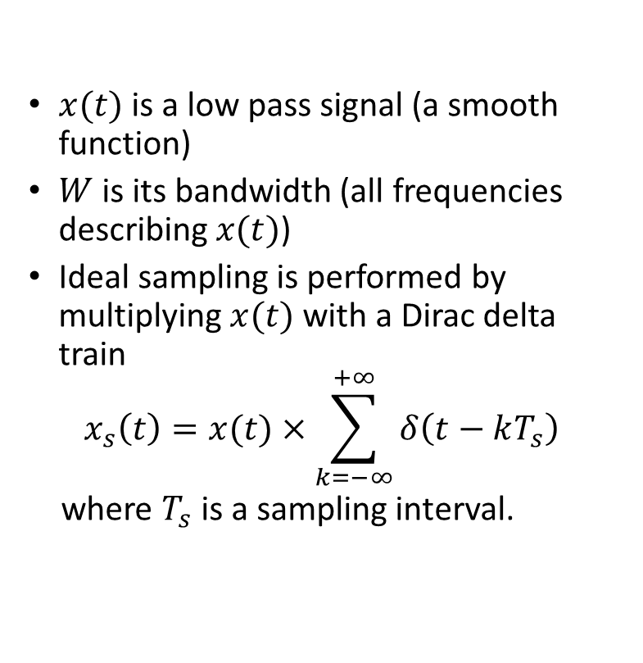
Ideal Sampling
$x(t)$ is a low pass signal (a smooth function)
$W$ is its bandwidth (all frequencies describing $x(t)$)
Ideal sampling is performed by multiplying $x(t)$ with a Dirac delta train
$$x_{s}\left(t\right)=x(t)×\sum_{k=−∞}^{+∞}{δ\left(t−kT_{s}\right)}$$
where $T_{s}$ is a sampling interval.

Slide 2
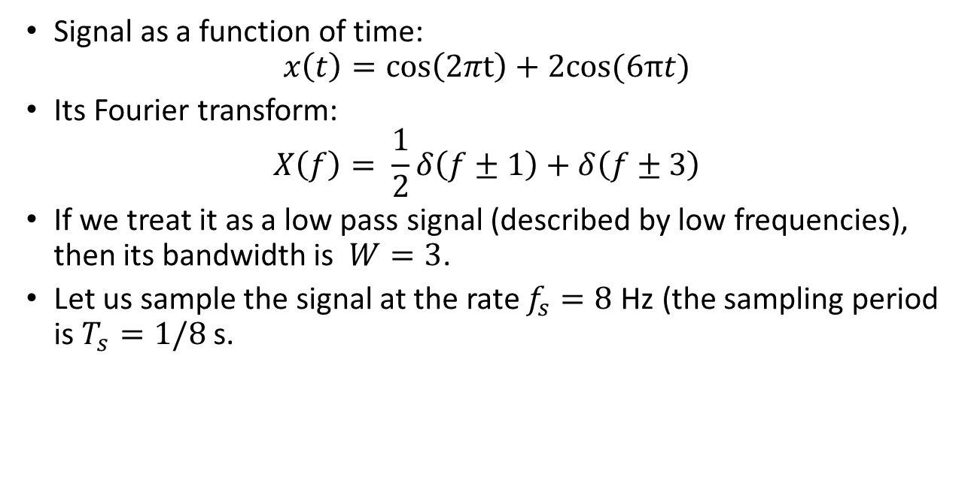
Illustration
Signal as a function of time:
$$x\left(t\right)=\cos\left(2πt\right)+2cos(6πt)$$
Its Fourier transform:
$$X\left(f\right)= \frac{1}{2}δ\left(f±1\right)+δ\left(f±3\right)$$
If we treat it as a low pass signal (described by low frequencies), then its bandwidth is $W=3$.
Let us sample the signal at the rate $f_{s}=8$ Hz (the sampling period is $T_{s}=1/8$ s.

Slide 3
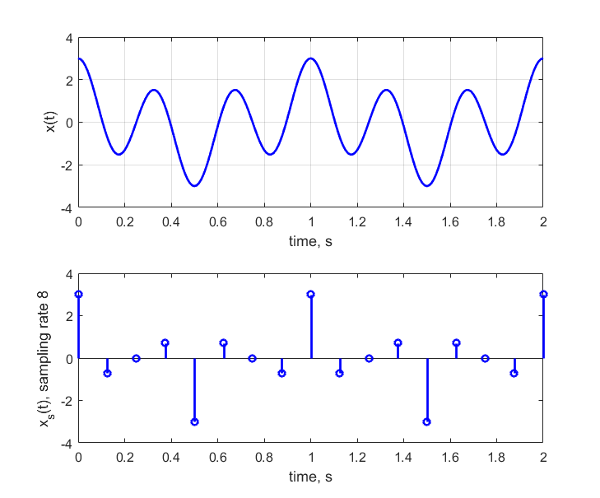
Illustration

Slide 4
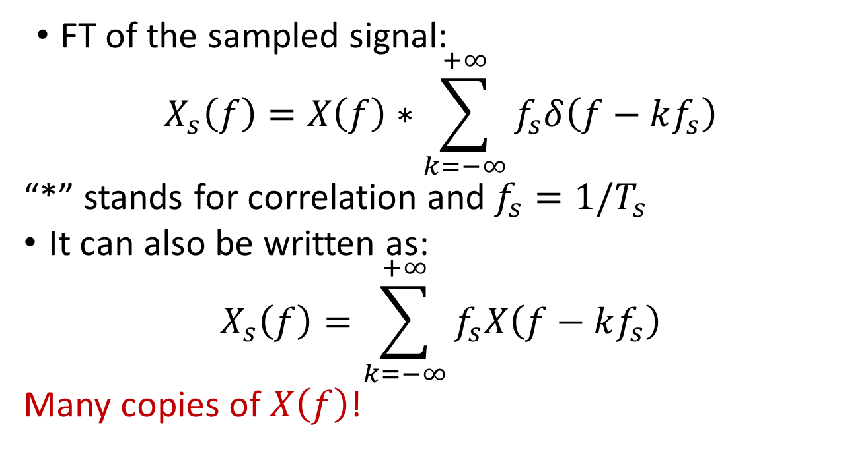
FT of sampled signal
FT of the sampled signal:
$$X_{s}\left(f\right)=X\left(f\right)∗\sum_{k=−∞}^{+∞}{f_{s}δ\left(f−kf_{s}\right)}$$
“*” stands for correlation and $f_{s}=1/T_{s}$
It can also be written as:
$$X_{s}\left(f\right)=\sum_{k=−∞}^{+∞}{f_{s}X\left(f−kf_{s}\right)}$$
Many copies of $X\left(f\right)$!

Slide 5
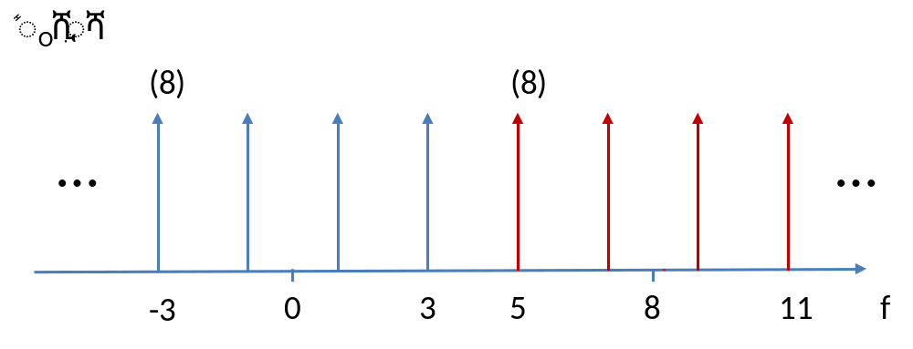
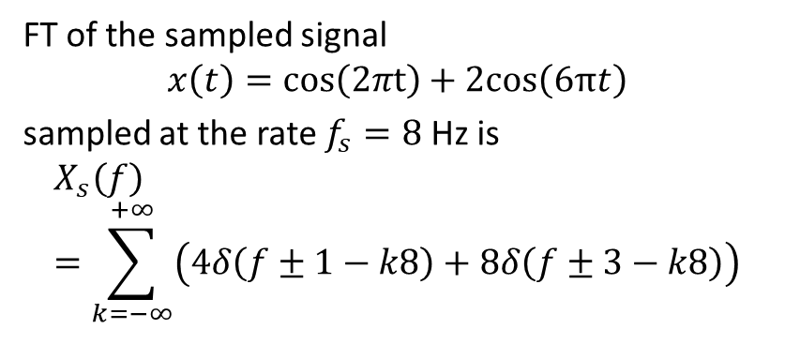
Back to illustration
FT of the sampled signal
$$x\left(t\right)=\cos\left(2πt\right)+2cos\left(6πt\right)$$
sampled at the rate $f_{s}=8$ Hz is
$$X_{s}\left(f\right)=\sum_{k=−∞}^{+∞}{\left(4δ\left(f±1−k8\right)+8δ\left(f±3−k8\right)\right)}$$

Slide 6
Nyquist Sampling Theorem
…
…
W=1000 is the bandwidth of a band pass signal
Find the smallest value of sampling rate such that spectral copies do not overlap.
.
.
- 4000
- 1000
0
1000
4000
f
…
…
.
.
.
.
- 2000
0
2000
f
2W
…
…
.
.
- 1000
0
1000

Slide 7
Nyquist Sampling Theorem
Assume that sampling frequency is high (spectral copies do not overlap)
How to recover the original spectrum?
…
…
(1/f )
s
.
.
- 4000
- 1000
0
1000
4000
f
W < f < f - W
cutoff
s
…
…
.
.
.
.
- 2000
0
2000
f

Slide 8
Sampling with Zero-Order Hold
Zero-order
hold
x(t)
x (t)
0
c(t)
x(t)
x (t)
0
X
Hold for T seconds

Slide 9
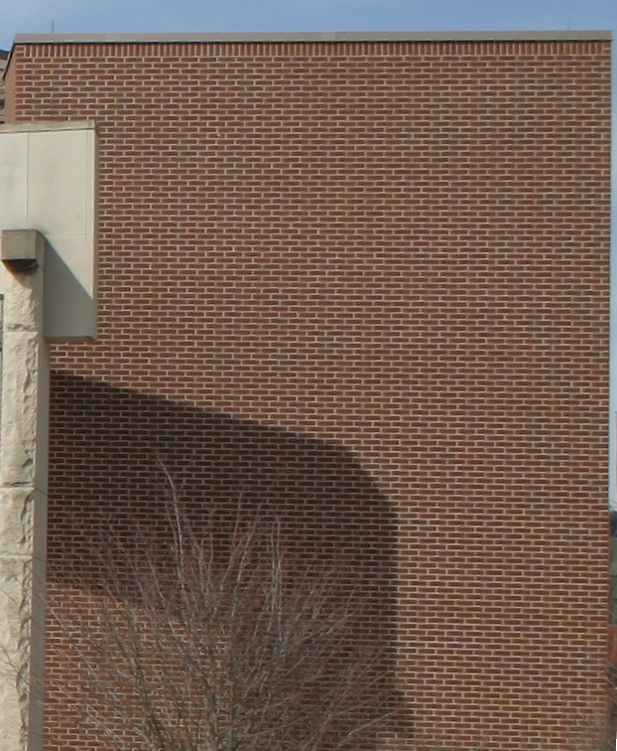
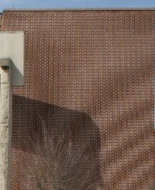
Aliasing
Left panel: Properly Sampled image of brick wall (493-by-599)
Right panel: Spatial aliasing in the form of a Moiré pattern (205-by-250)
http://en.wikipedia.org/wiki/Aliasing

Slide 10
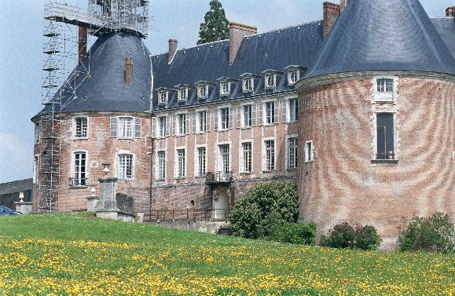

Aliasing (another example)
Aliasing due to undersampling
Application of anti-aliasing filter

